Slide 1
Enjoy English 3
Unit1 lessons 4,5

Slide 2
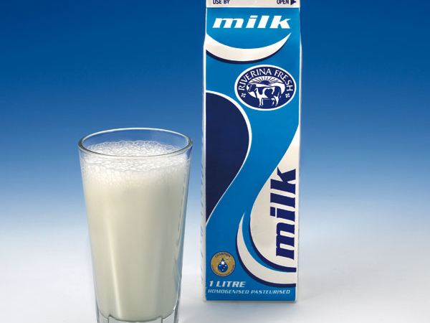
milk

Slide 3

juice

Slide 4
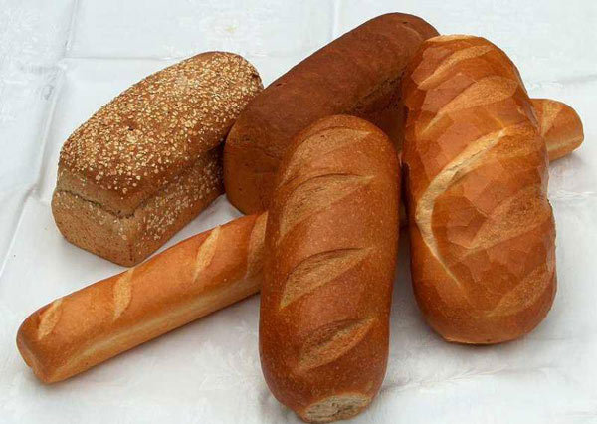
bread

Slide 5
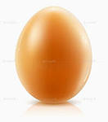
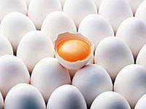
an egg eggs

Slide 6
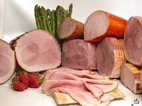
ham

Slide 7
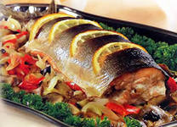
fish

Slide 8
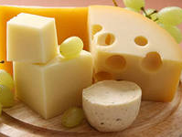
cheese

Slide 9

butter

Slide 10
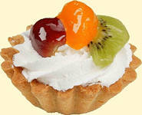
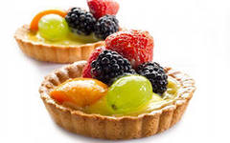
a cake cakes

Slide 11
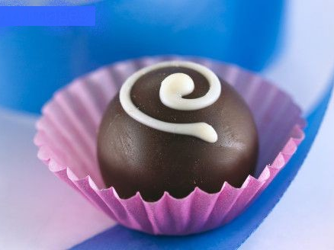
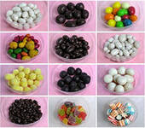
a sweet sweets

Slide 22
-Do you like….? - Yes, I do./ - No, I don`t.

Slide 23
- ar [a:] (перед согласной)
park
farm
farmer
smart
car
dark
are
Mark

Slide 24
- ar [a:] (перед согласной)
car are dark Mark farmer smart farm park

Slide 25
Do you like ? ( Ты любишь…?)
Would you like (some)….? (Ты хочешь немного…?)
- Yes, I do. / -No,I don`t.
Yes, please. / -No, thank you.
Help yourself! (Угощайся!)

Slide 26
-Do you like ?
-Would you like (some)….?
- Yes, I do. / -No,I don`t.
Yes, please. / -No, thank you.
Help yourself!

